Slide 1
Major Assignment 1
Monthly budget, income analysis and conversion

Slide 2

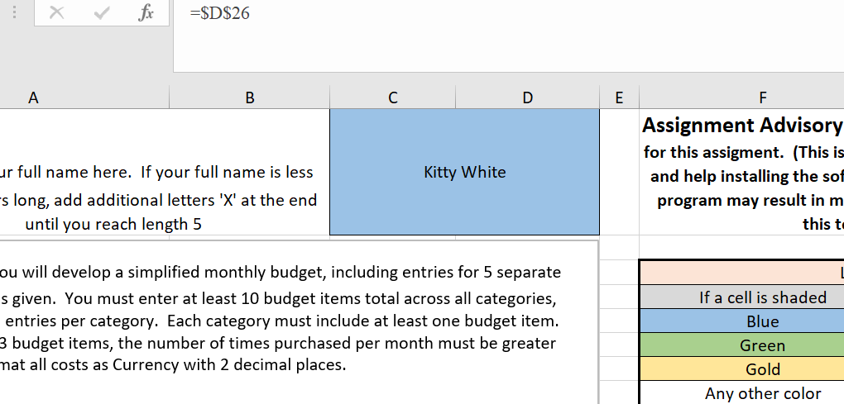
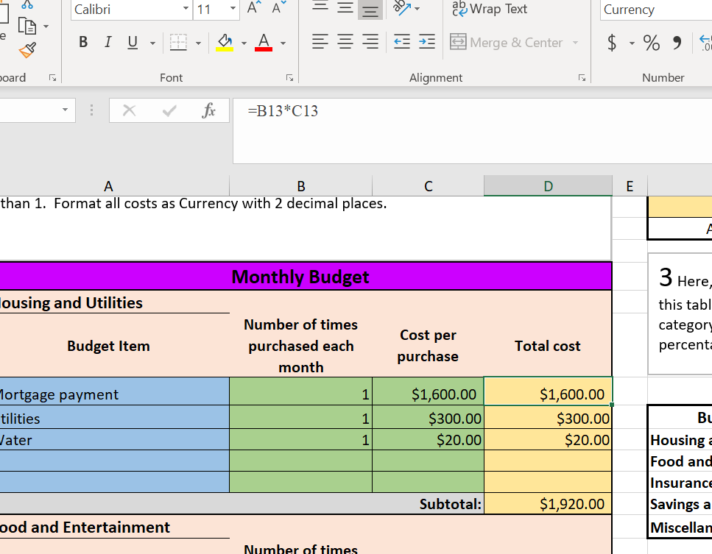
Monthly Budget
Let’s get started.
1. Don’t forget to enter your name in Question 1.
2. Remember to enter the formulas in yellow cells, e.g., =(Number of)*(Cost per) in Total cost.
3. Don’t forget the subtotals, e.g., =SUM(“Total cost”).

Slide 3
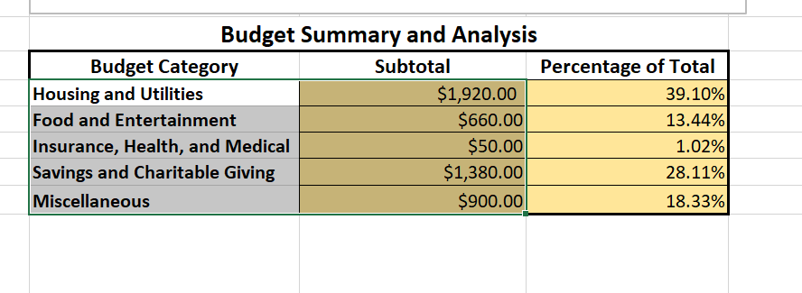
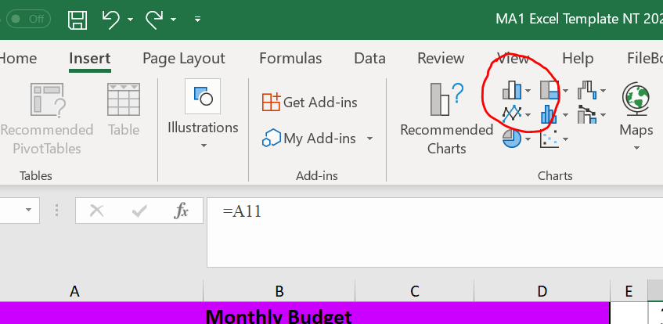
Monthly Budget
1. For the histogram, highlight both Budget Category and Subtotal.
2. Click “Insert” and choose the icon circled in red. That will automatically creates a histogram.
For the pie chart, the process is similar. When you highlight the second column (% of total), press Ctrl and click. That will select the second column. Then choose a pie directly below the red circle.

Slide 4
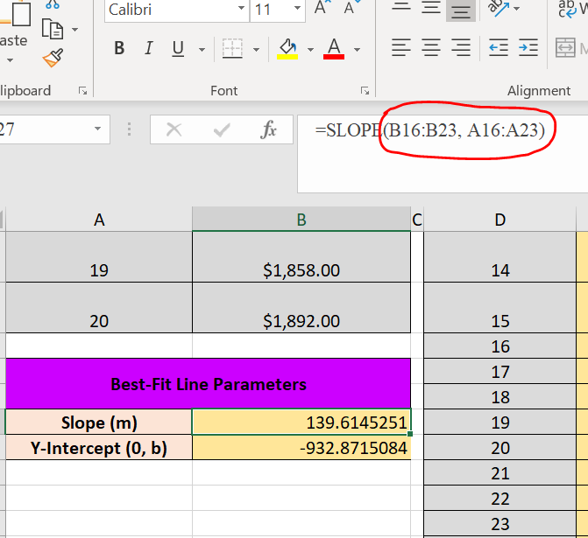
Income Analysis
1. In slope and Y-intercept, you need to find the slope and the y-intercept respectively.
2. Slope is explained here: https://support.microsoft.com/en-us/office/slope-function-11fb8f97-3117-4813-98aa-61d7e01276b9
3. Intercept is explained here: https://support.microsoft.com/en-us/office/intercept-function-2a9b74e2-9d47-4772-b663-3bca70bf63ef
4. Notice the order of variables inside the parenthesis.

Slide 5
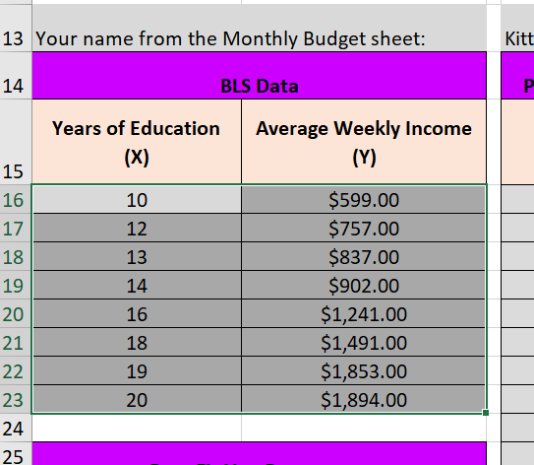
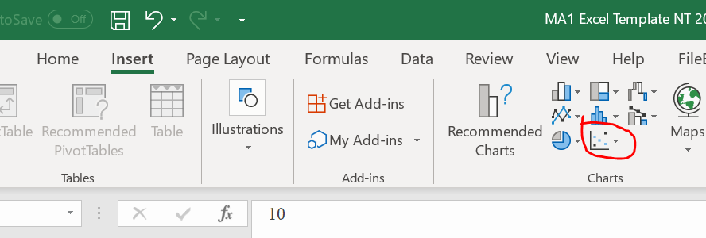
Income Analysis (Scatterplot)
1. Highlight the cells.
Choose “Insert” and select the icon circled in red.

Slide 6
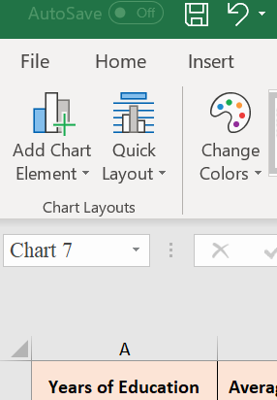
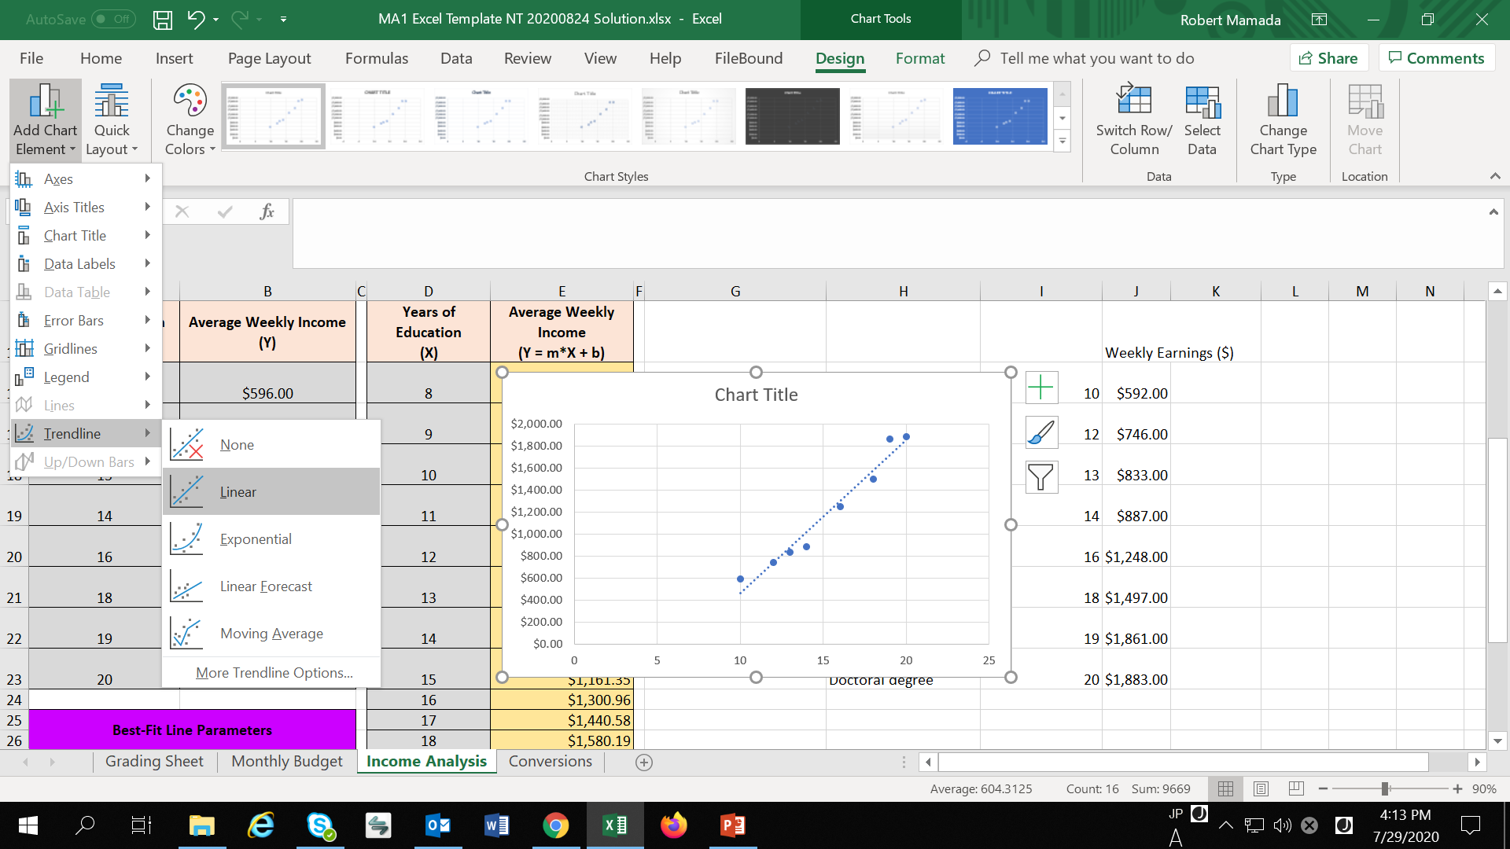
Income Analysis (Scatterplot)
1. Once the scatterplot shows up, choose “Add Chart Element.”
Choose “Trendline” and “Linear.”

Slide 7
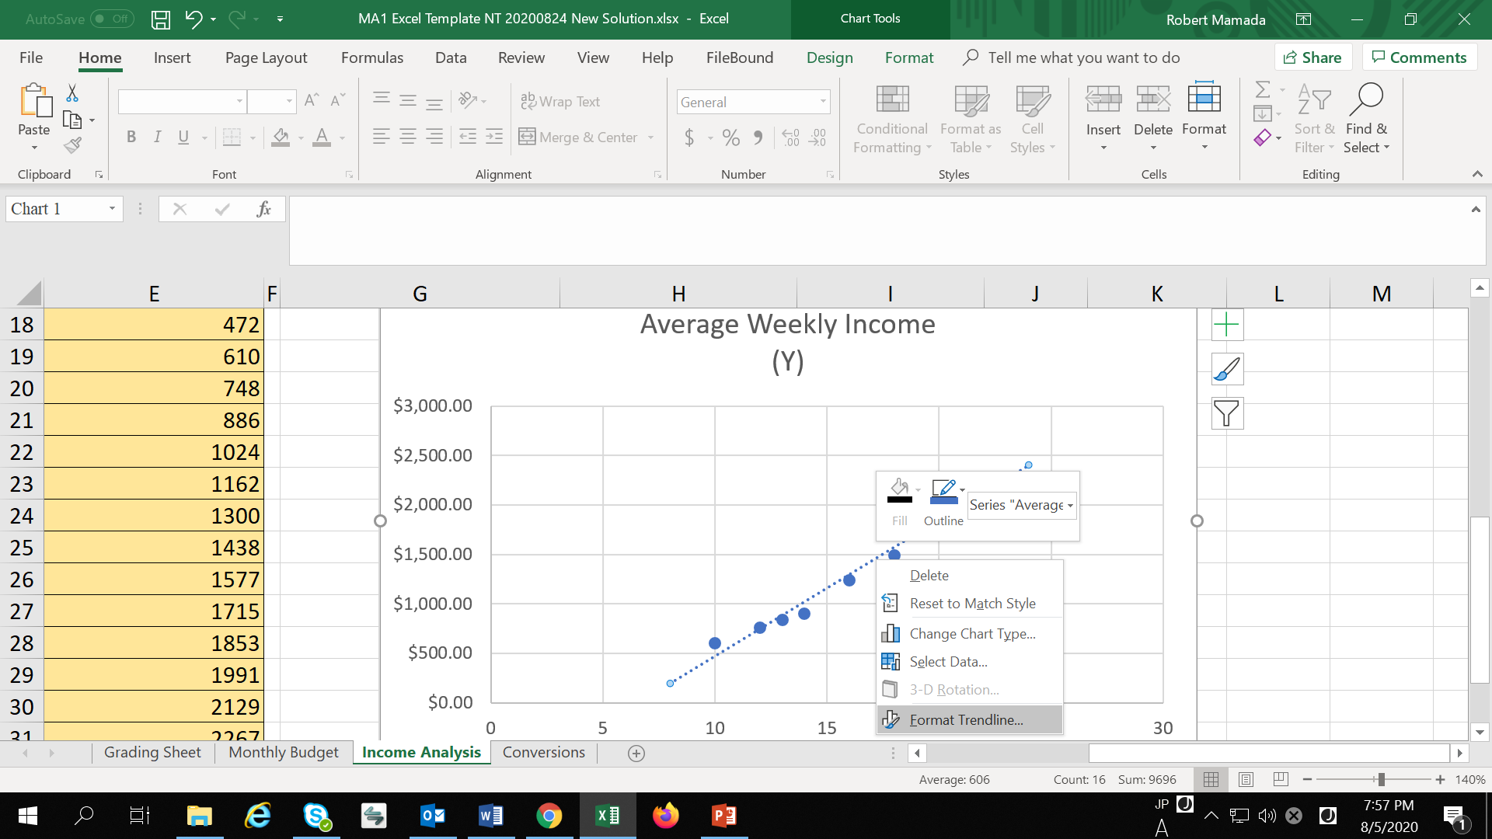
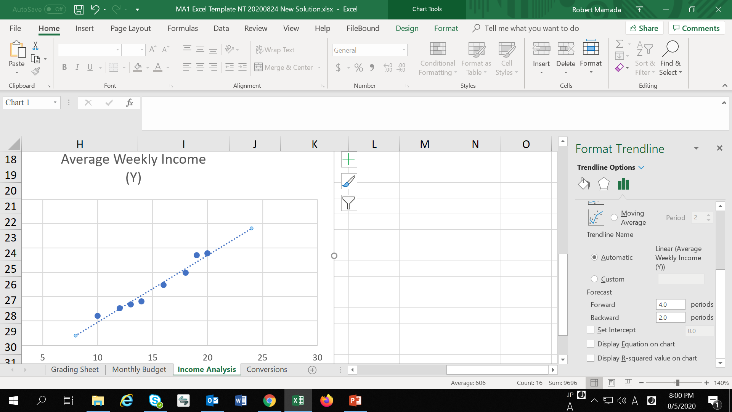
Income Analysis (Scatterplot)
Right-click the trend line and choose “Format trendline.”
Next, choose the appropriate amount for “Forward” and “Backward.”

Slide 8
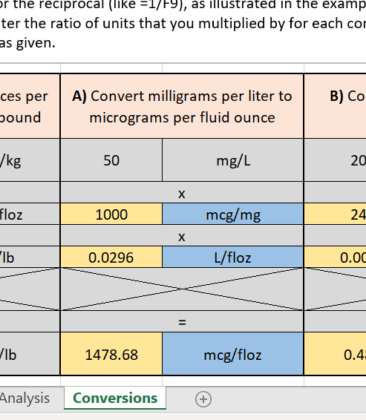
Conversions
Make sure to look for appropriate factors from the table above.
In yellow cells, you need to enter formulas (e.g., I entered =D17 and 1000 appeared).
In blue cells, you need to enter units.

Slide 9
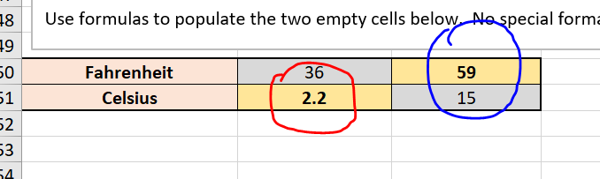
Conversions (Temperature)
Make sure to enter the formulas (Do not use your calculator).
For the red circle, use = (5/9)*(F - 32).
For the blue circle, use = (9/5)*C + 32.

